Slide 1
Chapter 8
Part 3

Slide 2
Sexual Reproduction

Slide 3
Reproduction in Human Beings
Puberty
Pubertal changes in males
Pubertal changes in females
Notes:
Human Beings reproduce by sexual reproduction.
Reproduction resulting from the fusion of male gamete and female gamete is called Sexual Reproduction, as we already mentioned before.
Now let’s talk about a few key terms involved in the reproduction phase in human beings.
Puberty is the age at which the gametes and sex hormones to be produced and the human being becomes sexually mature is called puberty. Generally, female pubertal age is 10-12 years, male pubertal age is 13-14 years. These are also called secondary sexual characters
Pubertal Changes in Males include, Widening shoulders, Deepening of voice, Growth of hair under armpits, chest, and around pubic area. It might also include an appearance of beard and moustaches, Increased activity of sweat and sebaceous glands, Oily skin and appearance of pimples.
Coming to females, Pubertal Changes includes, Widening of pelvis and hips. High pitch voice, Growth of hair under armpits and around the public area similar to males. Initiation of menstrual cycle, and the Growth of mammary glands

Slide 4
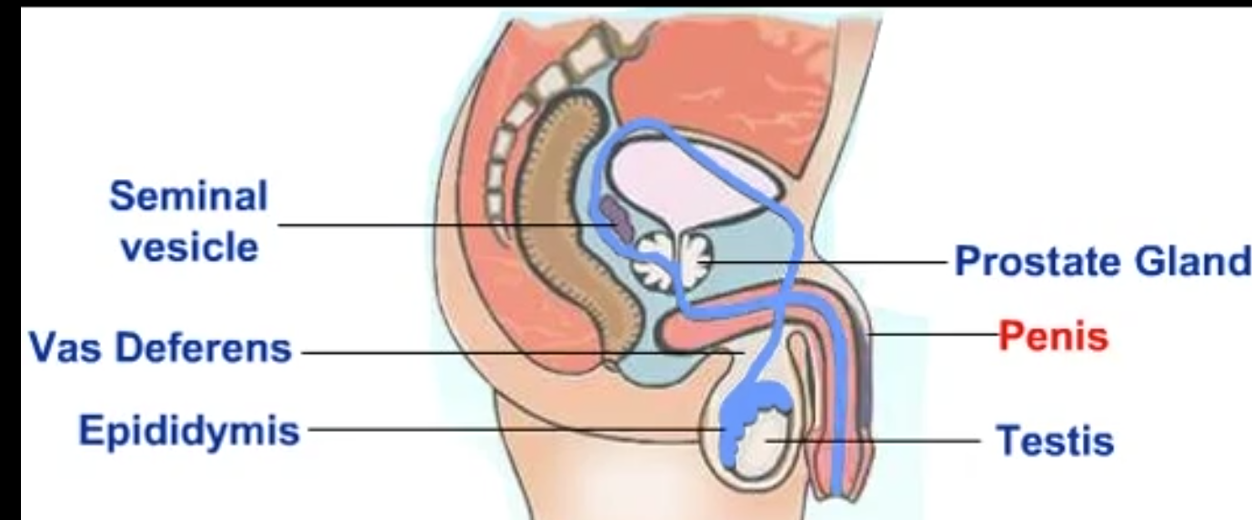
Male Reproductive System
Testes
Prostrate Glad
Urethra
Penis
Notes:
In the male reproductive system, The testes are the primary organs.
Animate the displayed picture
Point out at the appropriate parts while the below paragraphs are read..
They are responsible for producing the male gamete known as the sperm by a process called as spermatogenesis.
This occurs in the seminiferous tubules of the testes.
The testes are also responsible for secreting the male reproductive hormone testosterone.
Laydig Cells of the testes synthesizes Testosterone. The hormone testosterone not only helps in the formation of the sperm but also in the development of secondary sexual characters in males such as deepening of the voice, facial and pubic hair during puberty. Male humans have two testes. They are situated in a bag of skin known as the scrotum. Scrotum lies outside the pelvic cavity. The Prostrate Gland is an accessory gland in males which pours its secretions into the sperm duct along with the seminal fluid from the testes and into the penis. The urethra Functions as a common pathway for the seminal fluid and urine in males. It is longer in males and shorter in females. And finally, penises Is an organ which lies outside the body and functions to eliminate both urine and semen.

Slide 5
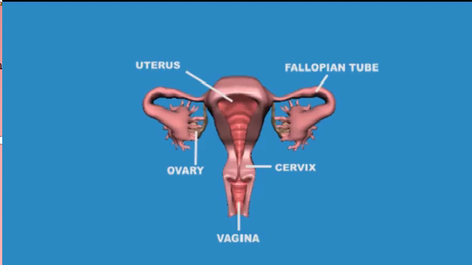
Female Reproductive System
Ovaries
Fallopian Tubes
Uterus
Cervix
Vagina
Urethra
Notes:
The female reproductive system in humans in entirely within the pelvic cavity. It comprises of ovaries, fallopian tubes, Uterus, Cervix, Vagina, and urethra.
Animate the displayed picture. Point out at the appropriate images accordingly while the below paragraph is read out
The ovaries give rise to the female gamete or the egg. Each ovary releases one egg alternatively each month. Ovulation is the process of release of an egg from either one of the ovaries. The Fallopian tubes, Also known as the oviducts, these tubes arise from the ovaries and end at the uterine fundus. Their function is to carry the egg once it is released into the uterus where it can fuse with the male sperm.
The Uterus It is a large muscular organ that is present in the pelvic cavity. The uterus is the region of action during the menstrual cycle, fertilization and the development of the fetus. And the Cervix Is a circular muscle ring that is present towards the lower end of the uterus that dilates at the time of delivery of the baby.
Now let us talk about the vagina. It Is a muscular tube-like structure that is present at the lower end of the cervix and leads towards the outside of the female body. The vagina functions as the pathway for the penis to enter the female body and deposit the sperms which then swim their way to the uterus to fertilize with the female egg.
And finally, the urethra in females is shorter than that found in males. In females, the urethra serves only for passage of urine.
The egg is formed under the influence of both female sex hormones estrogen and progesterone. This process is known as Oogenesis.

Slide 6
Fertilization Process
How does the fertilization in humans take place?
Sexual Intercourse
Implantation
Placenta
Estrogen
Progesterone
Notes:
The male gametes i.e the sperms are deposited in the female body by the process called as sexual intercourse. Once the sperms are deposited in the vagina, they need to travel upwards to reach the egg that is released from the ovaries and picked up by the fallopian tubes. When the sperm meets the egg, it needs to penetrate through its layers to cause fertilization. Both the Egg and the Sperm fertilize and form the diploid zygote. These will attach themselves to the inner wall of the uterus.
The attachment of the embryo to the uterine wall is called implantation. The tissues between the growing embryo and the mother’s uterine walls form the placenta. Placenta functions to provide nutrition to the embryo until its birth.
The hormones estrogen and progesterone both help in maintaining the placenta and the fetus inside the uterus.
The normal gestation period for humans is 38 weeks which is a little over 9 months.
At the end of this term, the uterine contractions begin under the influence of hormones.
A major hormone that plays a role in the oxytocin.
It affects the cervix and causes it to dilate, to allow the baby to pass outside the body of the mother.
The umbilical cord with its blood vessels and the placenta are also expelled along with the baby

Slide 7
Menstrual Cycle
Occurs during puberty in females
If the egg is not fertilized, it’ll be sent out through the vagina along with little blood. This is called menstrual cycle.
Occurs once in 28-34 days
Notes:
This is a biological process that occurs in human females from the time they attain puberty.
When a girl child is born, the primary oocytes already occur.
When the child reaches puberty, the process of meiosis continues to give rise to the secondary oocyte.
This secondary oocyte is released from each ovary alternatively in every alternate month.
Each ovary releases this secondary oocyte alternative The fallopian tube picks it up and transports it to the uterus.
The surface of the ovary that has released the egg is called the corpus luteum. It releases progesterone.
If the egg doesn’t fertilize, the corpus luteum disintegrates after 14 days and the progesterone levels fall.
This causes disintegration of the uterine lining which is called menses and it occurs every 28-34 days.
If fertilization occurs, the corpus luteum stays and no shedding of the uterine lining occurs. The uterus prepares for the implantation of the fetus.

Slide 8
Reproductive Health
STD’s
Protection
Notes:
Reproductive health involves preventing the chances of STDs. STD stands for sexually transmitted diseases. A few of them are gonorrhea, Herpes, syphilis, AIDS, Hepatitis B. AIDS and Hepatitis .
It also include preventing unwanted children. All of these can be prevented by using protection. Most common ways of prevention are the usage of condoms and birth control pills. But birth control may fail to work sometimes, which might result in unwanted pregnancy
Reproductive health means a couple should be able to enjoy the reproductive phase of its life; without taking the burden of gigantic family.

Slide 9
Conclusion
We learnt about
Reproduction in human beings
The Male and Female Reproductive system.
Reproductive Health

